Slide 1
ONLINE PRODUCT DELIVERY SYSTEM
PRESENTED BY:
GOWTHAMI.M
RAMKUMAR.S
DHARMARAJ.S

Slide 2
Introduction
The online product delivery system application enables vendors to set up online shops , customers to browse through the shops, and a system administrator to approve and reject requests for new shops and maintain lists of shop categories. Also the developer is designing an online shopping site to manage the items in the shop and also help customers to purchase them online without visiting the shop physically. The online shopping system will use the internet as the sole method for selling goods to its consumers

Slide 3
MODULES
1.PRODUCt
This module deals with selecting the products to be purchased and adding to the cart.
2.CUSTOMER
This module deals with the registration of customer. Customer should enter all his/her details i.e. the details of the customer like name, email address, password, etc. Registration successful and customer is allowed to logged in the website. so that he/she can access most of the features available in the website.

Slide 4
3.USER This feature deals with login and register and view product. 4.CART This feature deals with the addition of items to the cart, update of the quantity of items and deletes the items from the cart.

Slide 5
5.ORDER Order screen shows all the selected items, here quantity as to be entered. And also option is provided to deselect the products. 6.ADDRESS The address module lets customers add or select the address for an order during the checkout flow. If a customer is signed in, any addresses that were previously saved for that customer are shown, and the customer can select among them. The customer can also add a new address. The address module is used for all items on an order that require shipping.

Slide 6
Technologies used
Database:
Oracle Database 11g Express Edition
Back-End:
Java
Spring Boot
Front-End:
HTML CSS
JavaScript
React Js

Slide 7
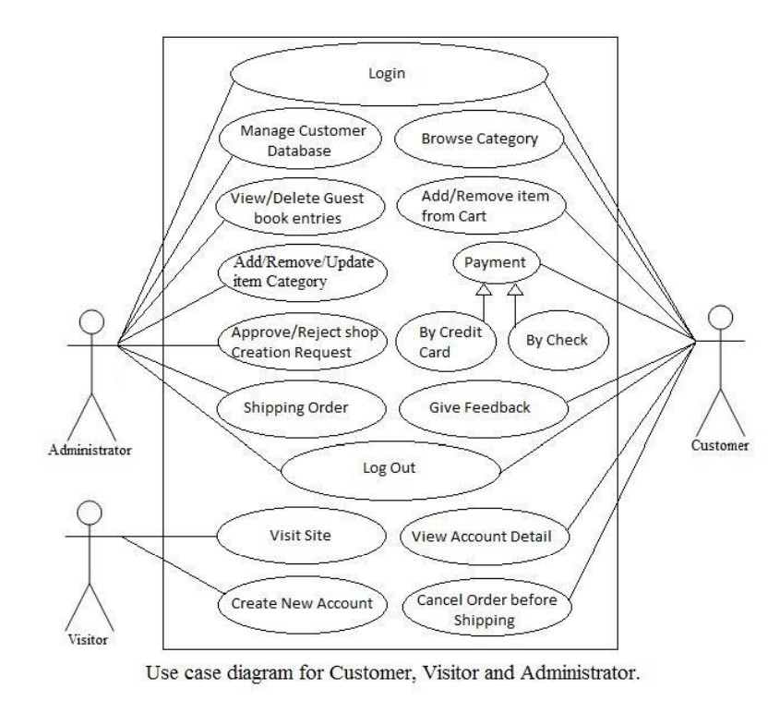
USE CASE DIAGRAM

Slide 8
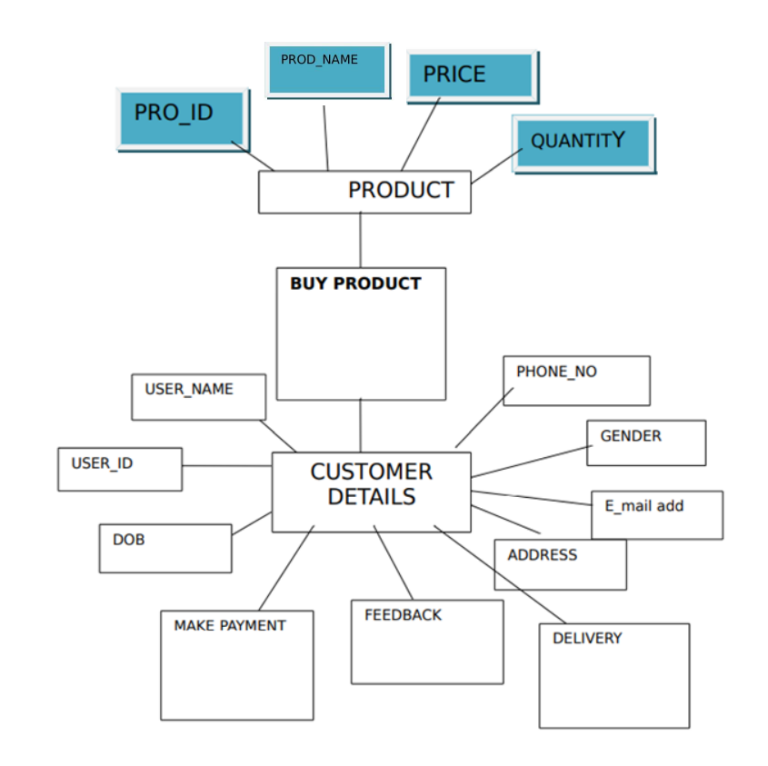
BLOCK DIAGRAM

Slide 9
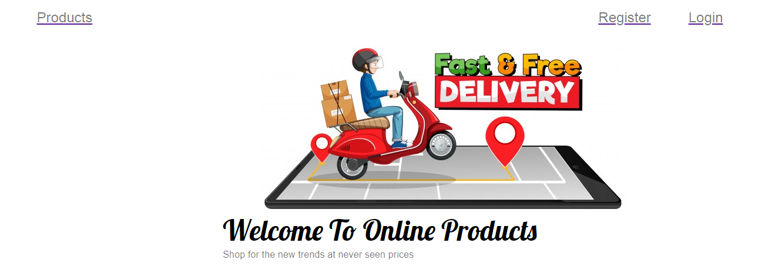

Slide 10
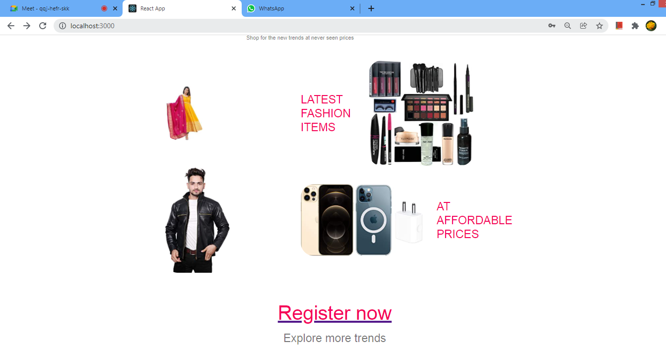

Slide 11
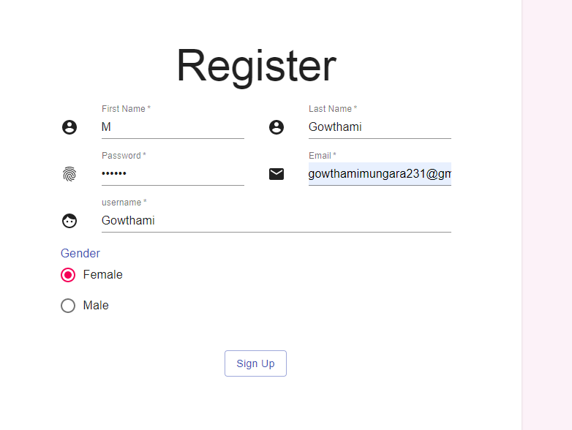

Slide 12
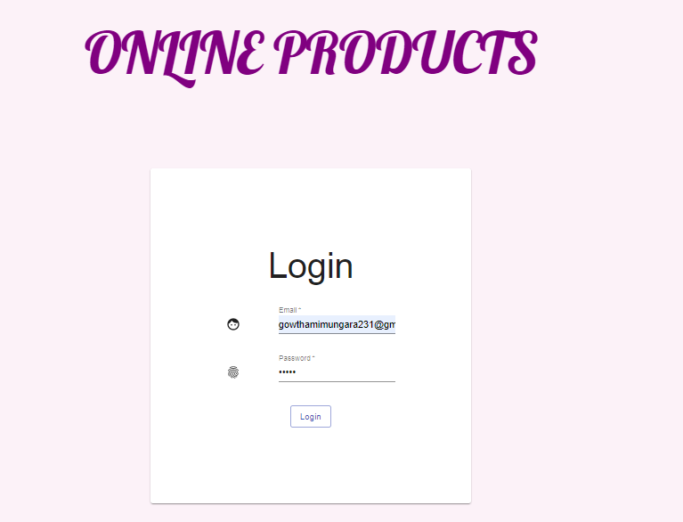

Slide 13
THANK YOU

